Slide 1
Customer Purchase Behaviour in Retail using Data Analytics
By,
Naveen Ramesh
BADM-WD-T-B5

Slide 2
Objective:
This is a capstone to learn data analysis and graphical display utilizing Excel, SQL, and Power BI in a retail and e-commerce dataset.
Approach:
The approach for this project is to focuses on equipping learners with comprehensive data analytics and visualization skills using Excel, SQL, and Power BI, also to ensures a thorough understanding and application of data-driven decision-making processes across retail and e-commerce domains.

Slide 3
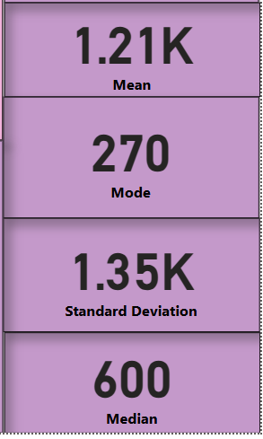
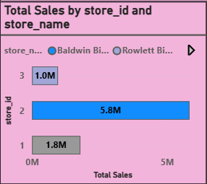
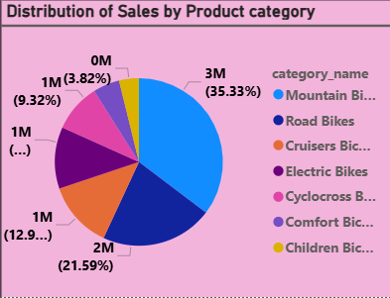
MS Excel Questions
Basic Summary Statistics:
To calculate the summary statistics (mean, median, mode, standard deviation) for the list_price of products.
Observations
Mean (1213) is much higher than the Median (600)
This suggests that the data is right-skewed, meaning a few high-priced products are increasing the average.
Mode (270) is the most common price
Many products are priced around 270, meaning lower-priced products dominate.
High Standard Deviation (1353)
A large spread in product prices, indicating high variability in pricing across the dataset.
Pivot Tables:
To create a pivot table to summarize total sales (quantity * list_price) by store and by product category.
Observations:
Top-Selling Categories:
Mountain Bikes (3,030,776)
Road Bikes (1,852,556)
Cruisers Bicycles (1,109,151)
Best Performing Store:
Store 2 (5,826,242 total sales) dominates all categories.
Least Sales:
Children Bicycles (327,888) and Cyclocross Bicycles (799,875) show lower sales.
Store 3 (962,601 total sales) needs improvement.
Metric | Value | Explanation
Mean (Average) | 1213 | The average price of all products.
Median | 600 | The middle value when prices are sorted.
Mode | 270 | The most frequently occurring price.
Standard Deviation | 1353 | High variability in prices, indicating a wide range of values.
Total Sales Made | Category Name
Store Name | Children Bicycles | Comfort Bicycles | Cruisers Bicycles | Cyclocross Bicycles | Electric Bikes | Mountain Bikes | Road Bikes | Grand Total
1 | 68937 | 95533 | 231683 | 179941 | 246439 | 627602 | 340009 | 1790146
2 | 227542 | 294930 | 759487 | 551722 | 667418 | 2054582 | 1270561 | 5826242
3 | 31409 | 48043 | 117981 | 68211 | 106380 | 348592 | 241985 | 962601
Grand Total | 327888 | 438507 | 1109151 | 799875 | 1020237 | 3030776 | 1852556 | 8578989

Slide 4
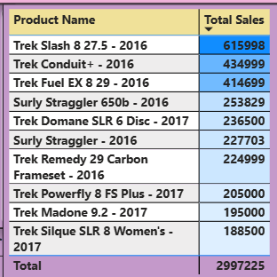
MS Excel Questions
Conditional Formatting:
Highlight the top 10 products based on total sales.
Observations:
Top 3 Best-Selling Products:
Trek Slash 8 27.5 - 2016 (615,998)
Trek Conduit+ - 2016 (434,999)
Trek Fuel EX 8 29 - 2016 (414,699)
2016 vs 2017 Sales:
2016 Models Dominate (7 out of 10 top products).
2017 Models like Trek Domane SLR 6 Disc (236,500) and Trek Powerfly 8 FS Plus (205,000) perform well but need more push.
Data Cleaning & Validation:
No missing values found, the Null values are replaced with Unknown.
No duplicates were found.
No formatting error.
Checked email and Zip code, no error found.
Product Name | Total Sales
Trek Slash 8 27.5 - 2016 | 615998
Trek Conduit+ - 2016 | 434999
Trek Fuel EX 8 29 - 2016 | 414699
Surly Straggler 650b - 2016 | 253829
Trek Domane SLR 6 Disc - 2017 | 236500
Surly Straggler - 2016 | 227703
Trek Remedy 29 Carbon Frameset - 2016 | 224999
Trek Powerfly 8 FS Plus - 2017 | 205000
Trek Madone 9.2 - 2017 | 195000
Trek Silque SLR 8 Women's - 2017 | 188500

Slide 5
MS Excel Questions
Charts and Graphs: Create a bar chart to visualize the total sales by store.
Observations
Baldwin Bikes leads significantly with 5.83M in total sales. Santa Cruz Bikes follows but lags far behind at 1.79M. Rowlett Bikes has the lowest total sales at 962K, indicating weak performance.
What-If Analysis: Perform a what-if analysis to see how changes in discount rates affect total sales.
Discount Rate | Total Sales ($)
0% | 480
5% | 570
10% | 540
15% | 510
20% | 480
25% | 450
30% | 420
Scenario | What It Means in Business Terms
0% Discount | Selling at full price without any discount. This gives you a steady revenue of $480.00.
5% Discount | Revenue increases to $569.99. This is because the small discount is encouraging customers to buy more, boosting revenue.
10% Discount | Revenue decreases slightly ($539.99) since you are cutting profit margins. Sales may still increase, but revenue drops.
20% Discount | Revenue drops significantly to $479.99. This means you're giving away too much profit margin.
30% Discount | Revenue has now fallen to $419.99. You are giving away too much discount, causing a sharp decline in revenue.

Slide 6
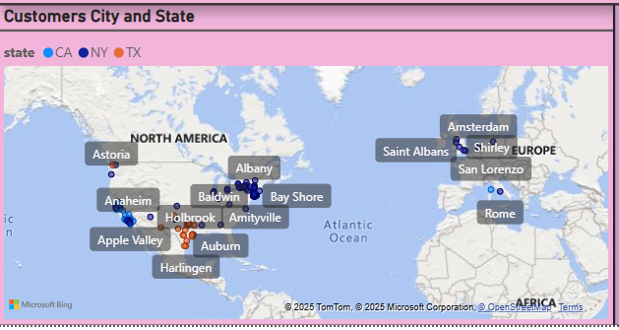
MS Excel Questions
Geographical Distribution(Excel data imported to Power Bi): Customers are mainly in the U.S. (CA, NY, TX) with some in Europe (Netherlands, Italy, UK, Spain). NY and TX have the highest concentration. Presence in Amsterdam, Rome, Saint Albans, Shirley, and San Lorenzo also found, but fewer than U.S. customers.
State-wise Categorization: CA (blue), NY (dark blue), TX (red). TX dominates the south, while NY has strong presence in the northeast.
Order Date | Sum of Sales Made | YoY Growth
2016 | 2709484.47
2017 | 3845515.02 | 42%
2018 | 2023989.39 | -47%
Year Over Year Growth:
Calculate the year-over-year growth rate for total sales
Observations:
2017 saw strong growth (+42%) compared to 2016, indicating a successful year. 2018 faced a steep decline (-47%), meaning sales dropped drastically. This indicates potential issues such as reduced demand, market shifts, or internal inefficiencies.
Customers Location - City & State:

Slide 7
Recommendations for Excel Questions
Discount Strategy: The high standard deviation suggests major price gaps, should consider offering discounts on high-priced items to boost sales.
Review Low-Priced Products: Many products are priced around 270, should Analyze if these low-priced items are profitable or need a price revision.
Segment Pricing: Group products into low, mid, and high price ranges.
Boost Sales in Store 3 – Focus on better promotions and product variety. Increase Inventory for Best-Selling Categories – Mountain & Road Bikes need more stock. Targeted Marketing for Low-Performing Categories – Improve Children & Cyclocross Bicycles sales.
Increase Stock for Top-Selling Models, Targeted Marketing for 2017 Models – Improve visibility for newer products and Seasonal Promotions & Discounts – Attract buyers for Surly Straggler & Trek Silque SLR 8 Women’s - 2017.
Revamp Marketing Strategies – Target lost customers and re-engage with promotions.
Expand Market Reach – Conduct surveys or customer feedback to understand low sales in Rowlett Bikes.
Analyze the sales drop in 2018 – Identify causes like competition, pricing, or economic conditions and should Optimize inventory, pricing, and supply chain to reduce costs.

Slide 8
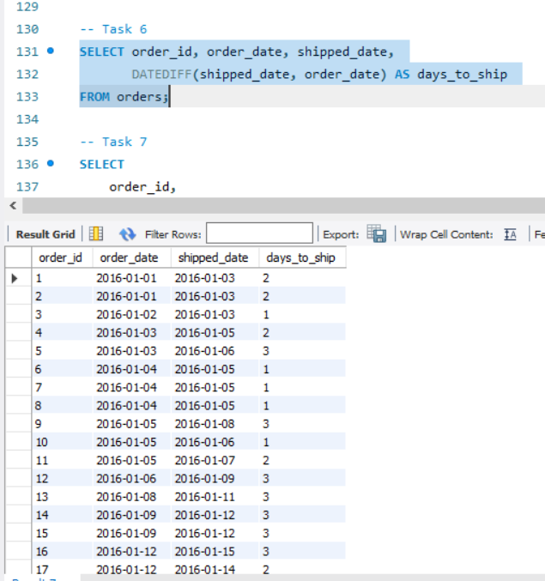
MySQL Questions
Date Functions: To calculate the number of days each order took to ship.
Observations:
The output accurately shows the number of days each order took to ship.
The values in the days_to_ship column range from 1 to 3 days.
Some orders took significantly longer to ship than others.

Slide 9
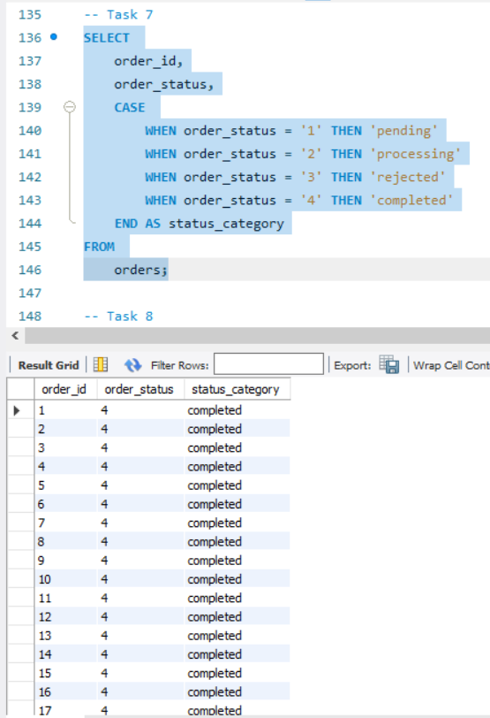
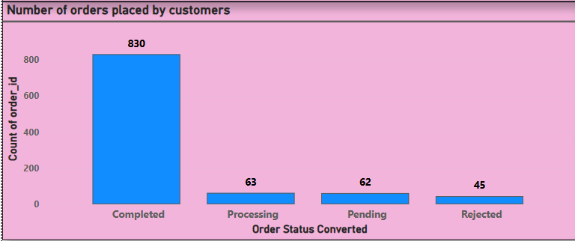
MySQL Questions
Case Statements: To categorize orders based on their status.
Observation:
Order statuses are categorized as Pending (1), Processing (2), Rejected (3), and Completed (4).
Indicates a diverse order status

Slide 10
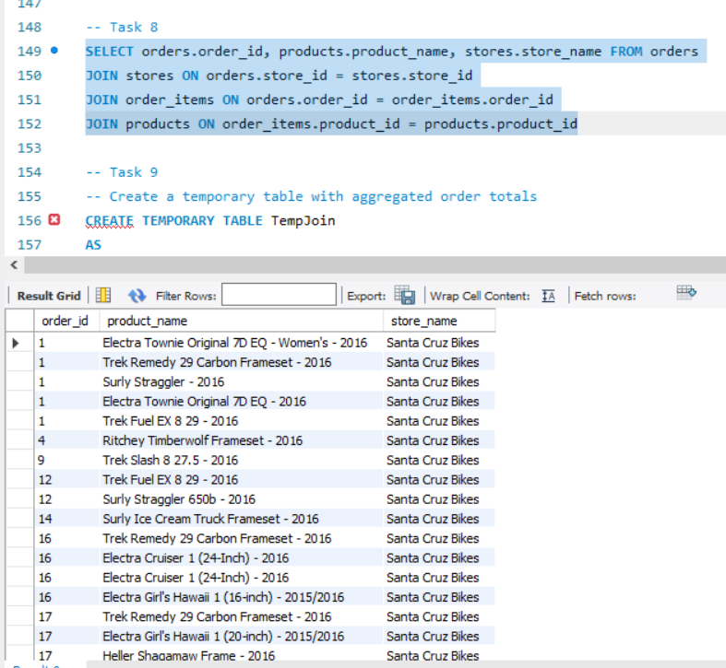
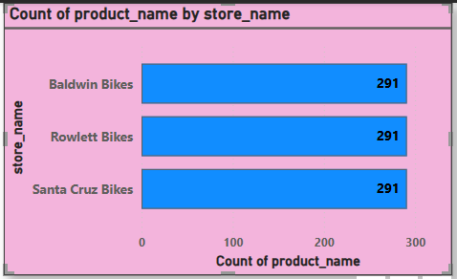
MySQL Questions
Complex Joins: To Retrieve all orders along with the product names and the store names.
Observation:
The output shows the difference products available in each store with respect to the order ID.
The products are evenly distributed

Slide 11
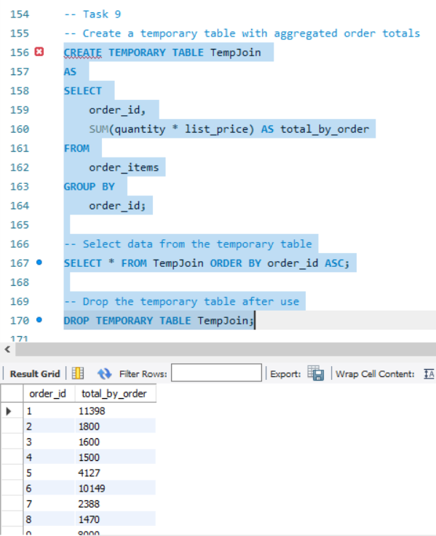
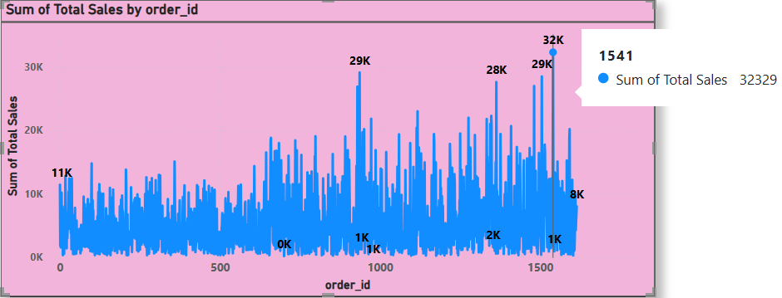
MySQL Questions
Temporary Tables:
To Create a temporary table to store intermediate sales calculations.
Observations: The output shows the total sales made for the particular Order ID.
The Order ID: 1541, has the highest total sales of 32K.

Slide 12
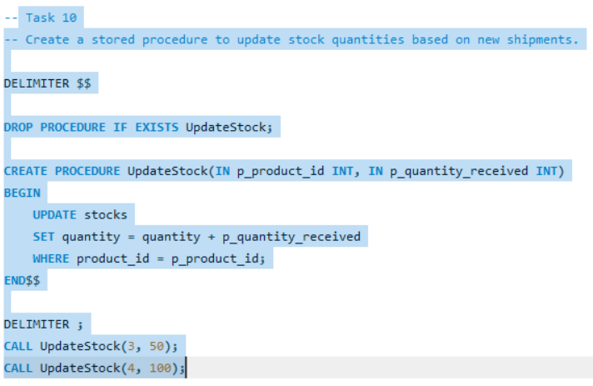
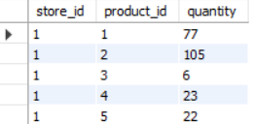
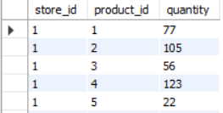
MySQL Questions
Stored Procedures: To Write a stored procedure to update stock quantities based on new shipments.
Observations:
Stored Procedure Functionality:
The UpdateStock procedure increments the quantity of a product in the stocks table when a new shipment arrives.
It takes two parameters: p_product_id (product identifier) and p_quantity_received (new stock quantity).
Stock Update Verification:
Before execution:
Product 3 had 6 units.
Product 4 had 23 units.
After calling UpdateStock(3, 50) and UpdateStock(4, 100):
Product 3 increased to 56 (6 + 50).
Product 4 increased to 123 (23 + 100).
The update process works correctly.
Business Impact:
Efficiently manages stock levels with automated updates.
Helps track inventory changes in real-time.

Slide 13
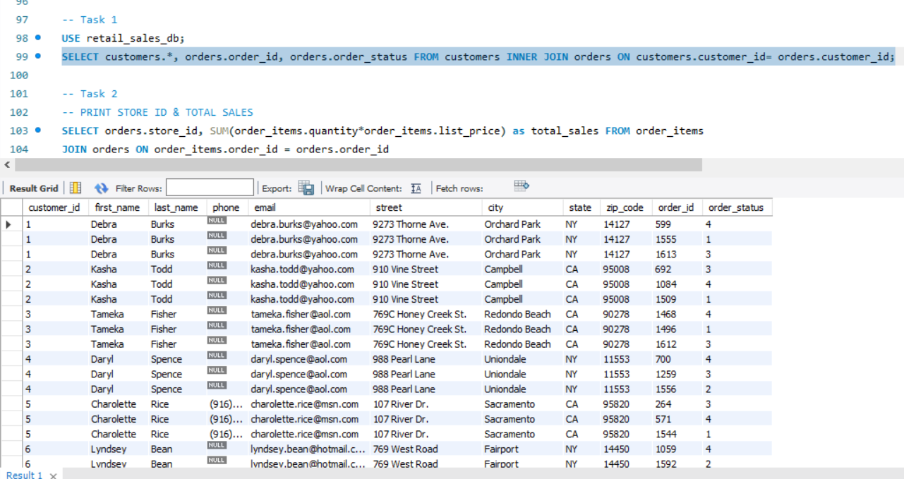
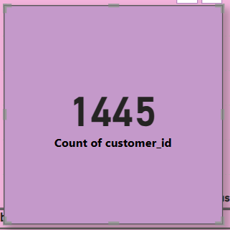
MySQL Questions
Basic Select Query(Output Imported to Power BI):
To Retrieve all details of customers who have placed orders.
Observations:
From the Output, it is found that there are 1445 unique customers who have placed orders. Out of which 830 customers orders has been completed, 63 proceesing, 62 pending and 45 were rejected.

Slide 14
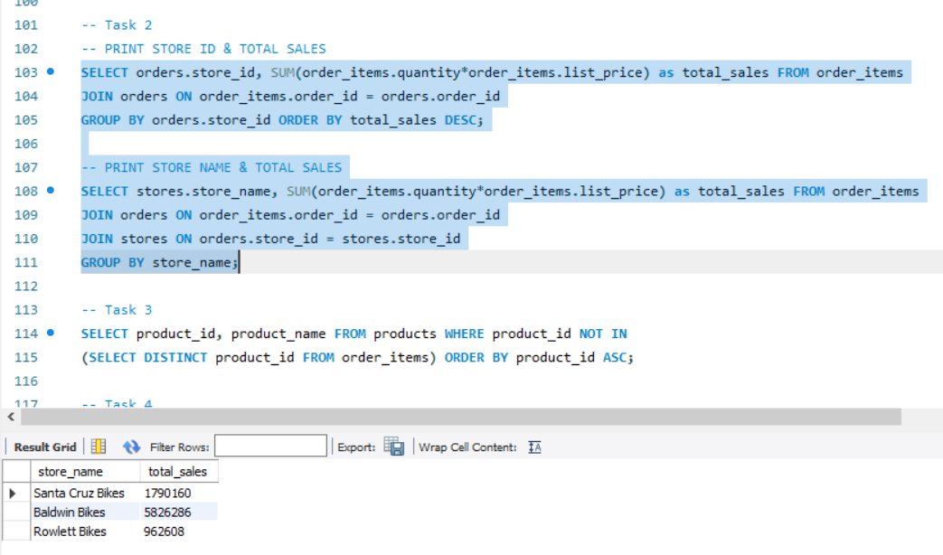
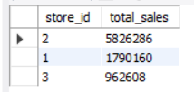
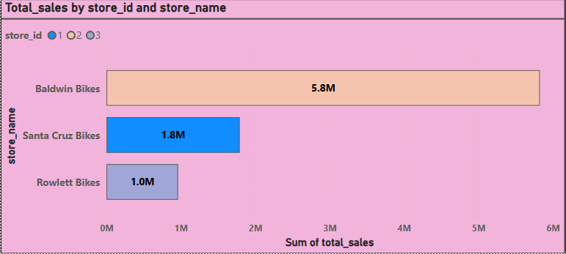
MySQL Questions
Load Total Sales by Store Data:
Observations:
Sales Distribution:
Store 2 (Baldwin Bikes) is the highest performer with 5.8M in total sales.
Store 1 (Santa Cruz Bikes) has 1.8M, significantly lower than Store 2.
Store 3 (Rowlett Bikes) is the lowest at 962K, underperforming compared to the others.
Sales Gap Analysis:
Store 2’s sales are over 3x higher than Store 1 and 6x higher than Store 3.
Store 3 needs significant improvement in sales performance.

Slide 15
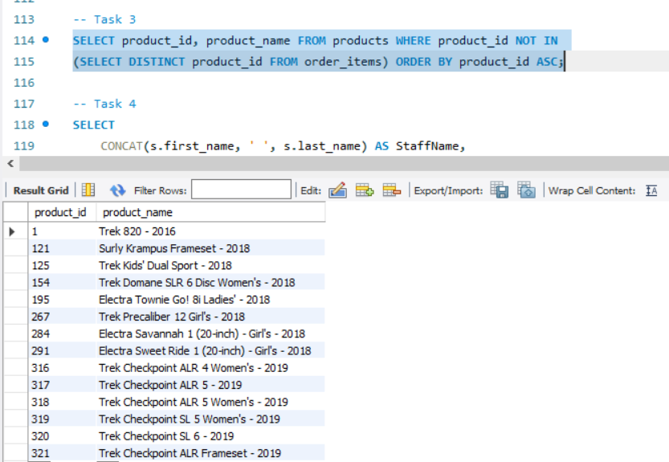
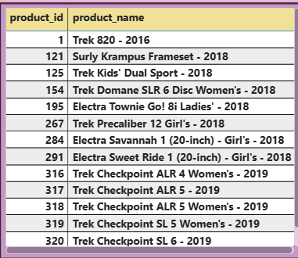
MySQL Questions
Load Products Never Ordered Data:
Observation:
The list includes a mix of kids', women's, and general bikes from brands like Trek and Electra.
Covers multiple categories: framesets, road bikes, and disc models.

Slide 16
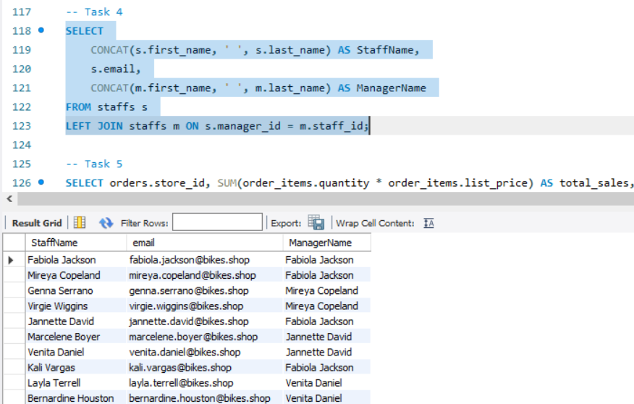
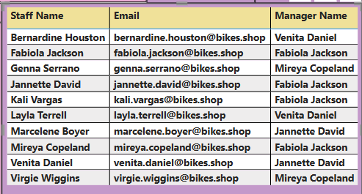
MySQL Questions
Joins: To Retrieve the names and email addresses of staff along with the names of their managers.
Observations:
Some managers (e.g., Fabiola Jackson) manage multiple employees (4 in this case).
Others, like Mireya Copeland and Venita Daniel, manage fewer staff members.

Slide 17
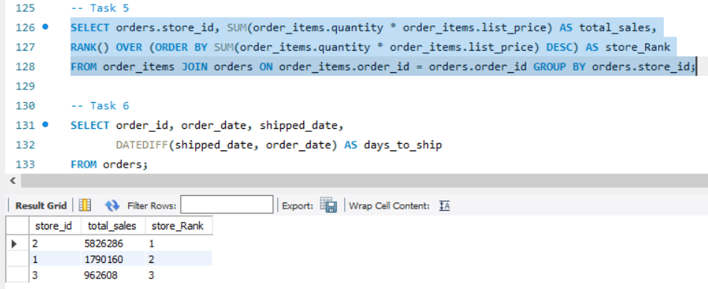
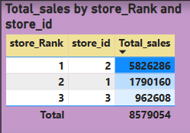
MySQL Questions
Window Functions:
To Rank stores based on their total sales.
Observation:
Top Performer:
Store 2 ranks #1 with the highest total sales: 5.83M, contributing the majority (approx. 68%) of the overall sales.
Mid Performer:
Store 1 ranks #2 with 1.79M in sales.
Lowest Sales:
Store 3 ranks last, generating only 0.96M, a small fraction (approx. 11%) of the total 8.58M sales.

Slide 18
Recommendations for SQL Questions
The majority of orders take 2-3 days to ship. Consider optimizing logistics to reduce this time. Identify orders that take longer than average and investigate potential causes (e.g., supplier delays, warehouse inefficiencies, carrier issues).
Analyze pending and rejected orders to identify operational bottlenecks.
Implement triggers to notify when stock levels are too low or too high.
Investigate Store 2's Success – Identify key factors (location, marketing, product demand) that contribute to its high sales and apply them to other stores. Boost Store 1 & 3 Performance – Enhance promotions, optimize product offerings, and improve customer experience to increase revenue.
Update Inventory: Include newer models (2020 and beyond) to stay competitive and meet current customer preferences. Analyze Sales Trends: Identify best-selling models and phase out slower-moving older bikes (e.g., 2016 model).
Reassign some employees from Fabiola Jackson to managers with fewer reports for better efficiency.
Analyze Store 2's Success: Investigate strategies/products/staffing in Store 2 and replicate success drivers across other stores.
Boost Store 3 Performance: Conduct sales training, marketing campaigns, or product mix evaluation for Store 3 to improve performance.
Resource Allocation: Invest more in high-performing stores (like Store 2) but also support underperformers (Store 3) to maximize overall revenue.

Slide 19
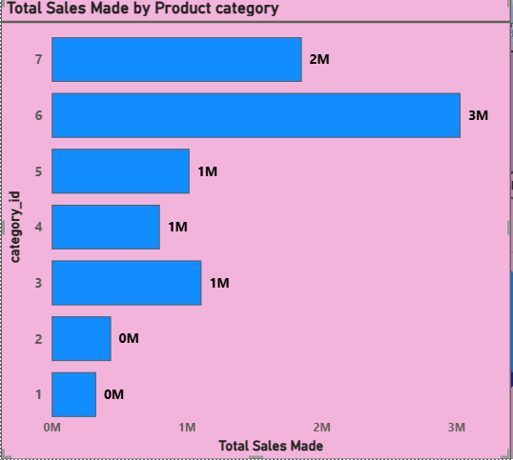
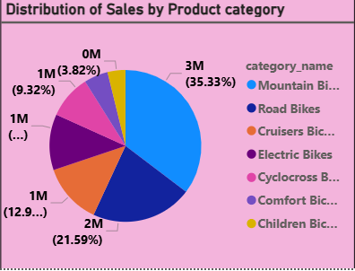
Power BI Questions
Basic Visualization:
Question: Create a bar chart to show total sales by product category.
Top-Selling Category:
Mountain Bikes dominate with 3M sales (35.33%) — the clear revenue driver.
Second Best:
Road Bikes follow with 2M sales (21.59%).
Mid-Level Sales:
Cruisers, Electric, and Cyclocross Bikes each bring in about 1M sales, accounting for 9–13% individually.
Low Performers:
Comfort and Children Bikes have negligible sales (328K), making up less than 4% combined.

Slide 20
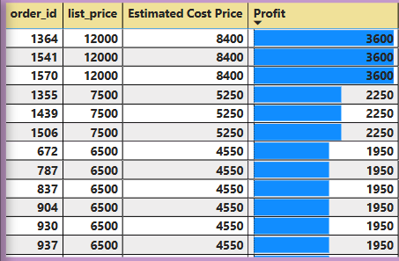
Power BI Questions
Calculated Columns:
Question: Create a calculated column to show the profit margin for each order item.
Observations:
Orders 1364, 1541, 1570 have the highest profit of ₹3600 each, from a ₹12000 list price.
Orders with a ₹7500 list price yield ₹2250 profit.

Slide 21
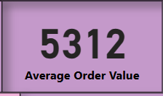
Power BI Questions
Measures: To Create a measure to calculate the average order value.
The Average Order Value (AOV), which represents the average revenue per order. It helps in understanding customer spending behavior.
On average, customers are spending ₹5312 per order.

Slide 22
Power BI Questions
Conditional Formatting:
Question: Apply conditional formatting to highlight top-performing stores.
Observations:
Top-selling product: Trek Slash 8 27.5 - 2016 with ₹615,998 in total sales.
Older models (2016-2017) still contribute significantly to total sales.
Total sales across all listed products: ₹2,997,225.
High sales concentration: The top 3 products alone contribute ~50% of total sales.

Slide 23
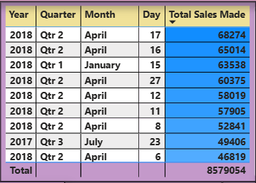
Power BI Questions
Table Visualization:
Question: Create a hierarchy for drill-down analysis of sales data by year, month, and day.
Observation:
This shows on each year, quarter, month and day, how much the total sales made(revenue) generated
April 17, 2018: $68,274 – This was the best-performing day in terms of total sales.

Slide 24
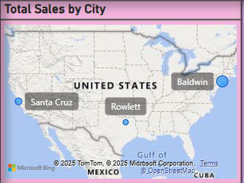
Power BI Questions
Custom Visuals:
Question: Utilize custom visuals to display geographic sales data.
Observations:
Top Sales Cities:
Baldwin (East Coast) appears to have the highest sales based on the bubble size.
Santa Cruz (West Coast) and Rowlett (South) also contribute to sales.
Geographical Spread:
Sales are distributed across different regions (West, South, and East).
The concentration seems higher in Baldwin compared to other cities.

Slide 25
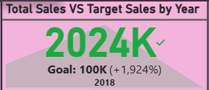
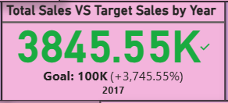
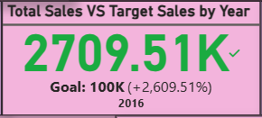
Power BI Questions
Key Performance Indicators (KPIs): To Create KPIs to track sales targets versus actual sales.
Key Insights:
2017 was the peak year with the highest total sales of $3.85M.
2018 experienced a decline in sales compared to 2017, but still performed exceptionally well above target.
2016 had strong growth, outperforming the sales target by 2,609.51%, laying a solid foundation for future years.

Slide 26
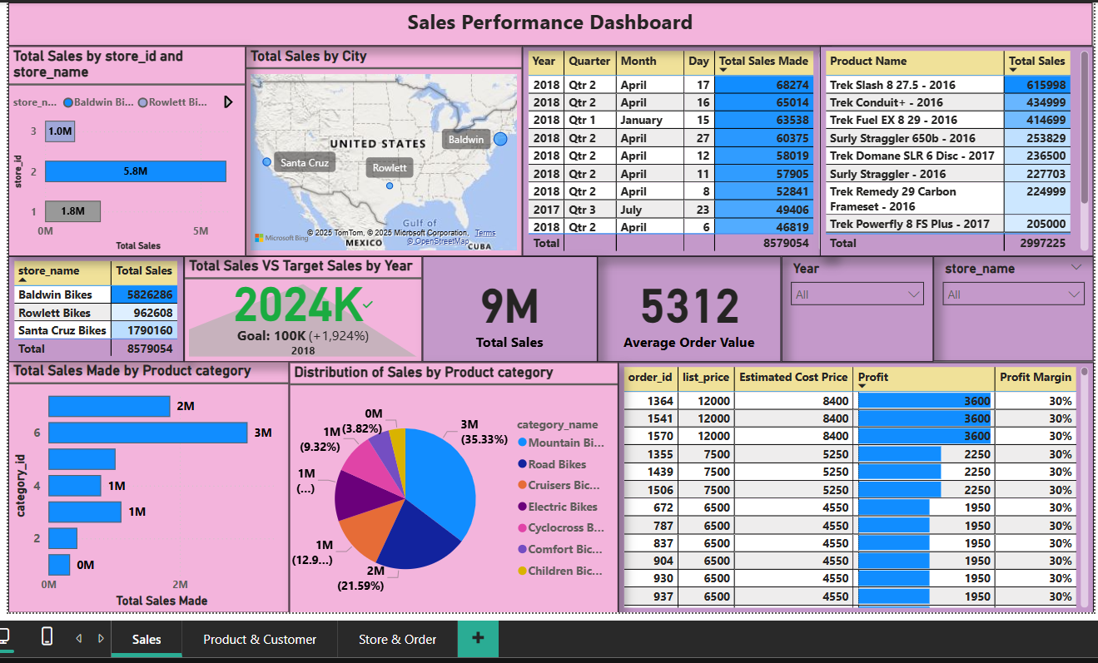
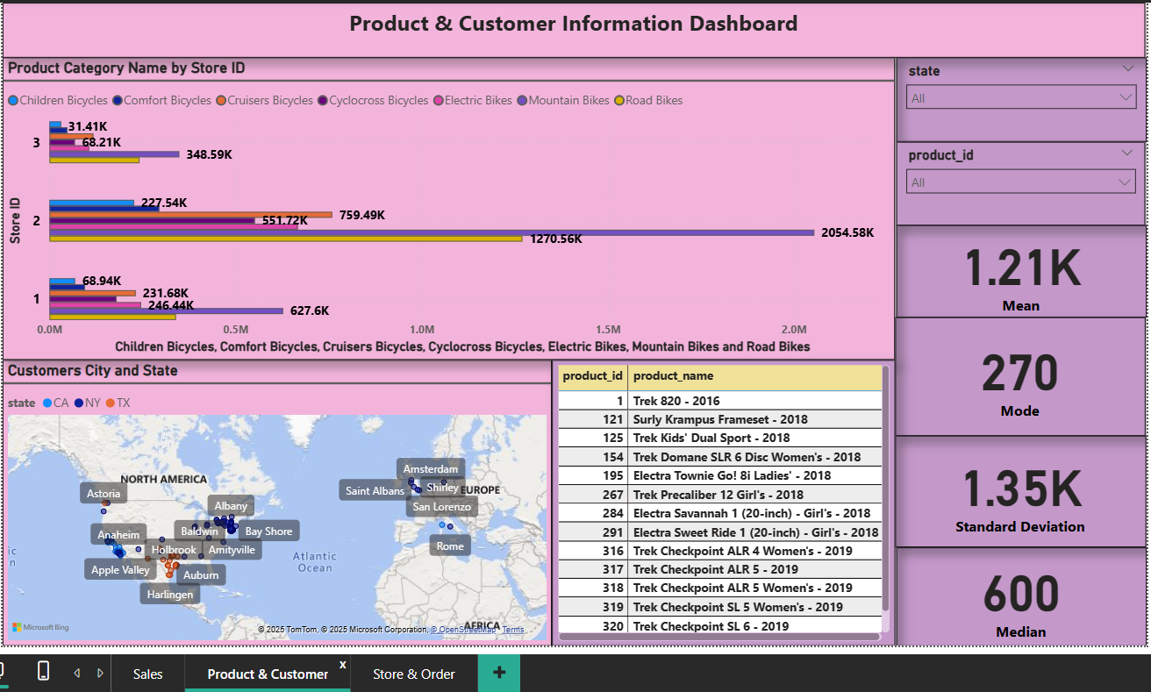
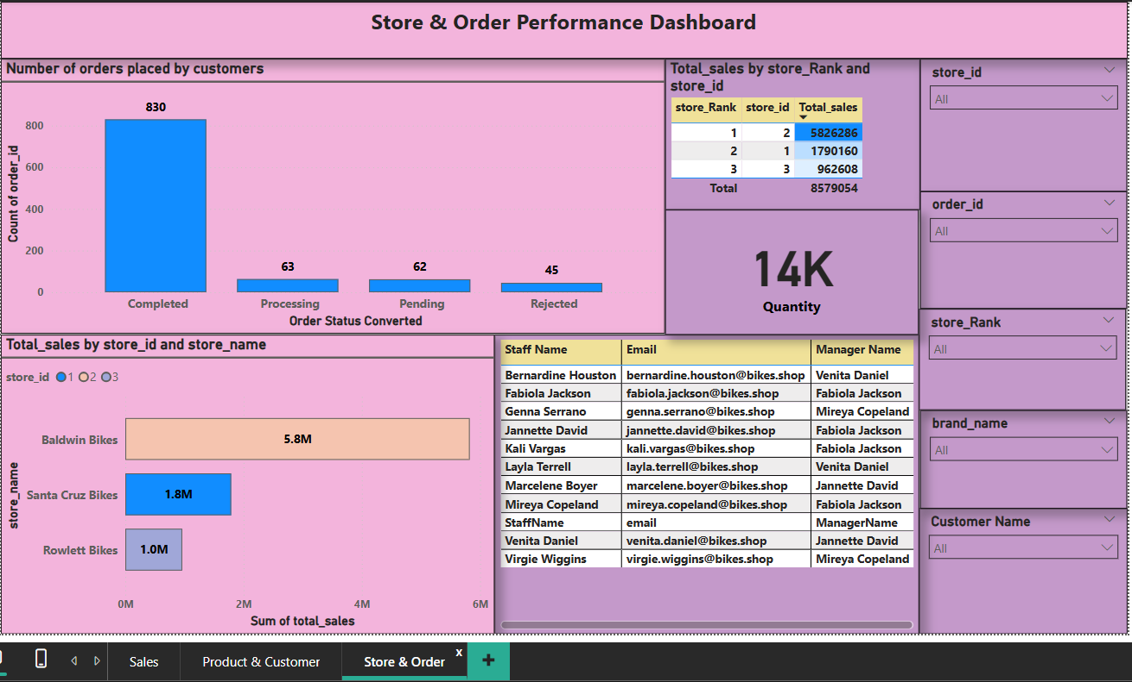
Power BI Dashboards

Slide 27
Recommendations for Power BI Questions
Prioritize inventory, marketing, and promotions for Mountain and Road Bikes to maximize profit.
Focus on upselling higher list price products (₹12000) due to their higher profit margins.
Implement bundle offers to encourage customers to buy more in a single purchase. Introduce discount thresholds.
Since all models are 2016-2017, introduce discounted pricing to clear inventory. Bundle accessories (helmets, bike locks) to increase overall revenue.
Focus promotions, ads, and local events in Baldwin, Santa Cruz, and Rowlett to boost engagement further. Consider city-specific discounts or loyalty programs.
Investigate the 2017 success factors: What contributed to the peak sales that year? Consider replicating strategies that worked.
Identify the cause of the 2018 drop: Was it market conditions, product changes, or competition?

Slide 28
Required Documents
Technical Document
Power BI Dashboard User Guide
Final Project: Excel Analyses

Slide 29
Conclusion
This project demonstrates the power of data analytics in retail decision-making.
Using Excel, SQL, and Power BI, we generated valuable insights into sales and customer behavior.
The findings help optimize inventory, improve sales, and enhance customer engagement.

Slide 30
THANK YOU!

